Slide 1
Integrated KVM-over-IP Solution
Distributed Workflow & Process Control

Slide 2
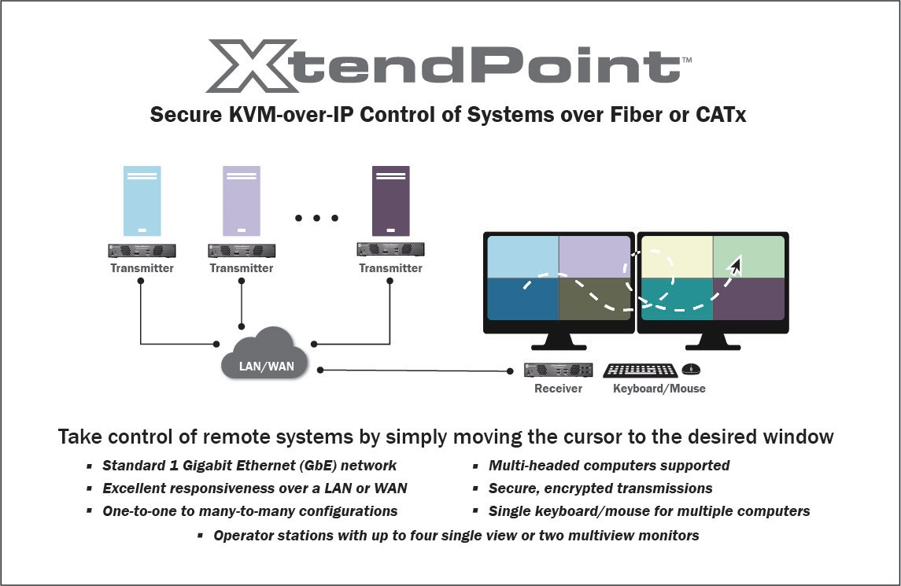
XtendPoint - Multi-Display KVM-over-IP

Slide 3
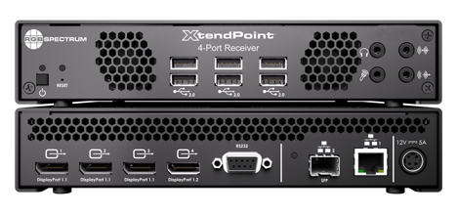
XtendPoint - Multi-Display KVM-over-IP
High performance KVM, video extension and switching system
Signals up to 4Kp60 and 4:4:4 color space
Source computers up to quad-head supported on a single end point
Point-to-point extension or networked operation
  One-to-one, many-to-one, one-to-many & many-to-many

Slide 4
XtendPoint – State–of-the-Art Features
Low bandwidth, low latency and high quality over standard 1Gbit network
Secure encrypted data and control
Fiber distribution for maximum security, with single mode and multi-mode options
Multiple remote computers controllable simultaneously across multiple monitors or multiviewers

Slide 5


XtendPoint - Connectivity
Standalone and Networked Connectivity
Point-to-Point Extension
Networked Operation
LAN

Slide 6


XtendPoint – Multi-Computer Control
Multi-Computer Control from Single XtendPoint Receiver
XtendPoint Transmitter
XtendPoint Receiver
Multiple monitors, Full screen
Dual monitors, Windowed
LAN
With KlickSimple™, a simple movement of the cursor transfers control to another computer system.

Slide 7


XtendPoint – Wall Processor Integration
View XtendPoint Streams on Galileo & Zio W4000 Videowalls
XtendPoint Transmitter
LAN
Galileo or Zio W4000

Slide 8

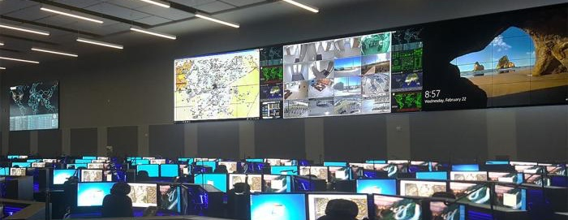
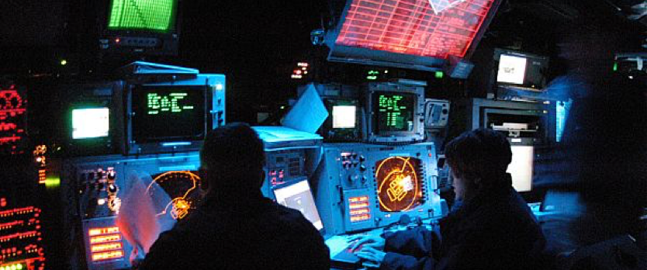
XtendPoint - Applications
Oil & Gas
Energy & Utilities
Public Safety
Security & Emergency Operations Centers
Military
Process Control
Air Traffic Control
Mining

Slide 9
XtendPoint - Specifications
Network
  1x RJ45 Gigabit Ethernet
  1 x SFP cage (single & multi-mode)
  Dual network link redundancy
Security
  AES encryption of video, audio & USB
  User access privileges via LDAP user management system or Active Directory
Control
  On-screen display (OSD)
  XtendPoint Central Manager application
XtendPoint Central Manager
  Device discovery, settings & status
  Manage device connections
  Manage user access privileges
Video
  DisplayPort input/output
  Color space: 4:4:4, RGB 8:8:8
  Resolutions
    1x 3840x2160p60
    2x 3840x2160p30 or
    2560x1600p60
    3x 1920x1200p60
    4x 1920x1080p60
Audio
  Embedded
  Line in / out
  Mic in / headphone out
USB & Serial
  USB 2.0
  RS-232

Slide 10
Thank you!
For more information: www.rgb.com/products/xtendpoint-kvm

